Slide 1


KPIs for pavement condition
At the Danish Road Directorate (DRD)
Armand Der-Stepanian, ards@vd.dk Niels Skov Dujardin, nsd@vd.dk

Slide 2
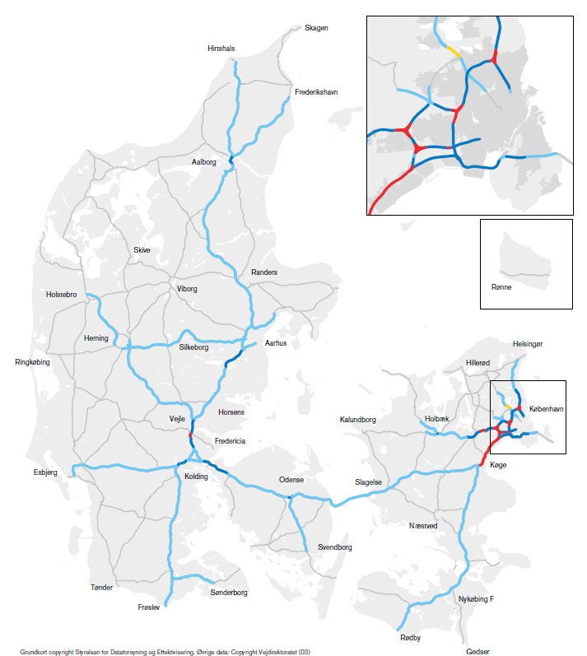
The Danish Road Directorate
KPIs for pavement condition – The Danish Road Directorate
Numbers and facts about the roads DRD manage.
Infrastructure:
Approximately 5 % of the road network in Denmark
Motorways 1227 km
Other roads 1588 km
Transport:
Approximately 50 % of the road transport in Denmark
Motorways 18,3 billions driven km a year
Other roads 7.2 billions driven km a year
Speed limits
58% of the motorways is 130 km/h
38% of the motorways is 110 km/h
Other roads is typically 80 km/h

Slide 3
Objective
KPIs for pavement condition – The Danish Road Directorate
Report pavement condition in general terms to non-experts
Report on network level
Pavement condition is based on measurement and not visual inspections
Economy is not part of the report
Do it on one page

Slide 4
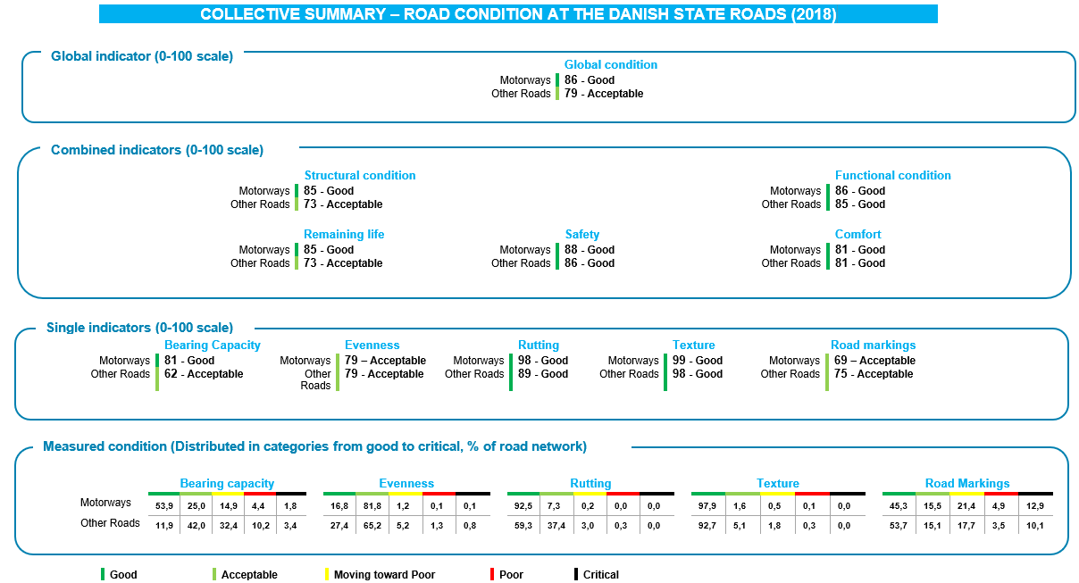

Slide 5
Evenness
KPIs for pavement condition – The Danish Road Directorate
 | GOOD | ACCEPTABLE | MOVING TOWARDS POOR | POOR | Critical
 | No maintenance | Minor maintenance effort | Part of the network need maintenance | Comprehensive maintenance is needed | Urgent need for maintenance
Motorways (IRI, m/km) | 0,8 and below | 0,9 – 1,6 | 1,7 – 2,4 | 2,5 – 3,2 | Above 3,2
Other roads (IRI, m/km) | 1,0 and below | 1,1 – 2,0 | 2,1 – 3,0 | 3,1 – 4,0 | Above 4,1
EVENNESS | Good comfort. No or very few uneven surfaces | Ordinary comfort. Some unevenness due to minor surface damages and/or patches. | Much unevenness is detected. In general the road will be perceived as uneven | Poor comfort, Can lead to safety issues. | Poor comfort with safety issues
Percentage on motorways 2018 | 16,8 % | 81,8 % | 1,2 % | 0,1 % | 0,1 %
Percentage on motorways 2017 | 18,6 % | 80,1 % | 1,2 % | 0,1 % | 0,1 %
Percentage on other roads 2018 | 27,4 % | 65,2 % | 5,2 % | 1,3 % | 0,8 %
Percentage on other roads 2017 | 23,9 % | 69,0 % | 5,2 % | 1,1 % | 0,8 %

Slide 6
Road Marking visibility
KPIs for pavement condition – The Danish Road Directorate
 | GOOD | ACCEPTABLE | MOVING TOWARDS POOR | POOR | Critical
 | No maintenance | Minor maintenance effort | Part of the network need maintenance | Comprehensive maintenance is needed | Urgent need for maintenance
(Retroreflecsion, mcd/lux/m²) | 150 and above | 130 - 149 | 100 - 129 | 90 - 99 | Below 90
Road Marking Visibility | The road marking appears new | The road marking is clearly visible and do not cause any safety issues | Road markings are visible but the drivers need to be focused. Visibility is problematic in rain and at night | The visibility is poor in any conditions. And will be a safety issue to the road users | Road markings are not visible and an urgent replacement is needed. It is not safe for the road users.
Percentage of road markings on motorways 2018 | 45,3 % | 15,5 % | 21,4 % | 4,9 % | 12,9 %
Percentage of road markings on motorways 2015-17 | 35,2 % | 16,7 % | 27,6 % | 10,7 % | 9,9 %
Percentage of road markings on other roads 2018 | 53,7 % | 15,1 % | 17,7 % | 3,5 % | 10,1 %
Percentage of road markings on other roads 2015-17 | 38,1 % | 18,6 % | 24,8 % | 8,9 % | 9,7 %

Slide 7
 | GOOD | ACCEPTABLE | MOVING TOWARD POOR | POOR | CRITICAL
 | No maintenance | Minor maintenance effort | Part of the network need maintenance | Comprehensive maintenance is needed | Urgent need for maintenance
BEARING CAPACITY (Remaining structural life based on TSD-screening) | 20 years or above | 15 – 19 years | 5 – 14 years | 0 – 4 years | below 0 years
 | Sufficient Bearing Capacity | Ordinary condition, minor part of the road network needs reinforcement | Reinforcement should be considered when paving a new wearing course | Moderate to high risk of insuficient bearing capacity. Reinforcement needed. | High risk of insuficient bearing capacity. Reinforcement needed.
EVENNESS (IRI, m/km) | 0,8 and below (motorways) 1,0 and below (Other roads) | 0,9 – 1,6 (motorways) 1,1 – 2,0 (Other roads) | 1,7 – 2,4 (motorways) 2,1 – 3,0 (Other roads) | 2,5 – 3,2 (motorways) 3,1 – 4,0 (Other roads) | above 3,2 (motorways) 4,1 – 5,0 (Other roads)
 | Good comfort. No or very few uneven surfaces | Ordinary comfort. Some unevenness due to minor surface damages and/or patches. | Much unevenness is detected. In general the road will be perceived as uneven | Poor comfort, Can lead to safety issues. | Poor comfort with safety issues
RUTTING (depth, mm) | 5 mm and below | 6 – 10 mm | 11 – 15 mm | 16 – 20 mm | above 20 mm
 | No rutting. No risk of aquaplanning | Discomfort when changing lanes. Low risk of aquaplanning | Risk of aquaplaning at heavy rain and high traficspeeds. Discomfort when changing lanes | Risk of aquaplaning and possibility of insuficient bearing capacity. The condition can be a saffety issue | High Risk of aquaplaning and properly insuficient bearing capacity
TEXTUR (MPD, mm) | 0,5 and above | 0,40 – 0,49 | 0,30 – 0,39 | 0,20 – 0,29 | below 0,20
 | Very low risk of insuficient friction | Low risk of insuficient friction | Moderate risk of insufient friction | High risk of incuficient friction | Very high risk of incuficient friction
ROAD MARKING VISIBILITY (mcd/m²/lux) | 150 and above | 130 - 149 | 100 - 129 | 90 - 99 | below 90
 | The road marking appears as new | The road marking is clearly visible and do not cause any safety issues | Road markings are visible but the drivers need to focus. Visibility is problematic in rain and at night | The visibility is poor in any conditions. And will be a safety issue to the road users | Road markings are not visible and an urgent replacement is needed. It is not safe for the road users.

Slide 8
Single indicators
KPIs for pavement condition – Danish Road Directorate
The Framework for Performance Indicators, PIARC 2004
Single indicators (0-100)
1 x percentage of the road network in the Good condition
+ 0,75 x percentage of the road network in the Acceptable condition
+ 0,5 x percentage of the road network in the Moving towards poor condition
+ 0,25 x percentage of the road network in the Poor condition
Value of condition indicator Qualitative assessment
80 – 100 Good
60 – 79 Acceptable
40 – 69 Moving towards poor
20 – 49 Poor
0 – 19 Critical

Slide 9
Combined and global indicators
KPIs for pavement condition – Danish Road Directorate
Combined indicators
Three KPIs from the Danish road standards (normally assessed visually)
Two new indicators
Global indicator
 | Bearing capacity | Eveness | Rutting | Texture | Road markings
Remaining life | 50% | 25% | 25%
Safety |  | 10% | 30% | 30% | 30%
Comfort |  | 50% | 25% |  | 25%
 | Bearing capacity | Eveness | Rutting | Texture | Road Markings
Structural condition | 50% | 25% | 25%
Functional condition |  | 25% | 25% | 25% | 25%
 | Structural condition | Functional condition
Global condition | 50 % | 50 %

Slide 11
Further work
KPIs for pavement condition – The Danish Road Directorate
In 2020 a Surface condition indicator will be added that will rely on results from an ARAN9000 with Pavemetrics LCMS2 lasers mounted. At least including:
Cracks
Raveling and/or pick outs
Potholes and delamination
Patches and sealings
In 2020 friction will be measured on network level to validate that our current texture screening is functioning correct.

Slide 12
Thank you
Armand Der-Stepanian, ards@vd.dk Niels Skov Dujardin, nsd@vd.dk

Slide 13
Road surface condition
Friction
Cracks raveling potholes Repairs
Cracks raveling potholes Repairs
Friction

